Slide 1
Data Mining
Support Vector Machines
Introduction to Data Mining, 2nd Edition
by
Tan, Steinbach, Karpatne, Kumar

Slide 2
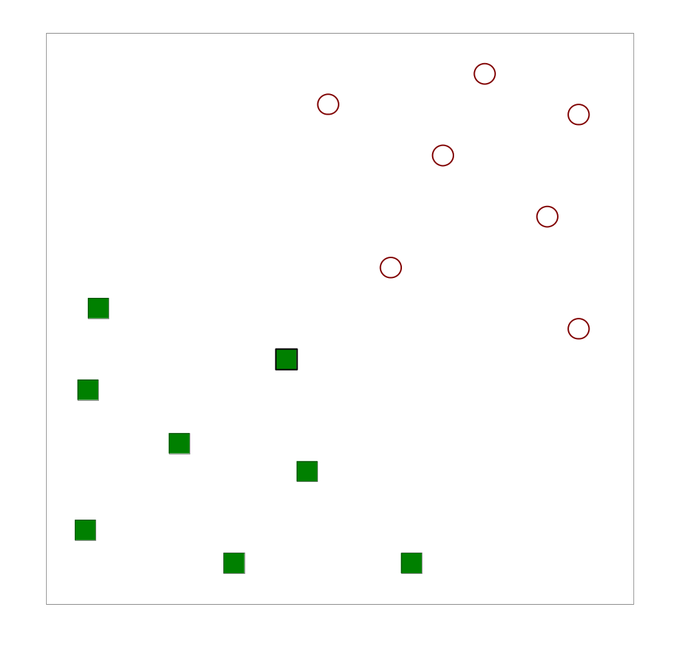
Support Vector Machines
Find a linear hyperplane (decision boundary) that will separate the data

Slide 3
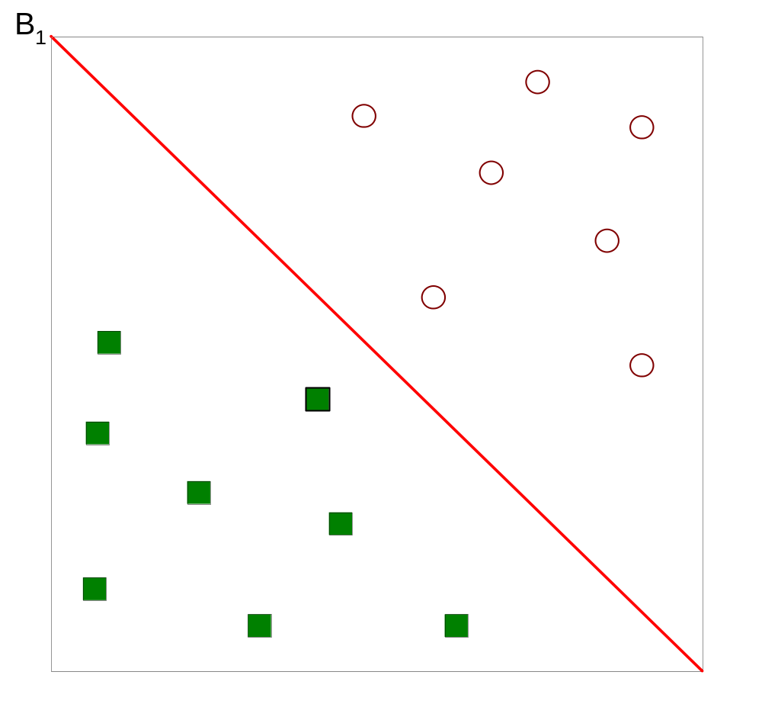
Support Vector Machines
One Possible Solution

Slide 4
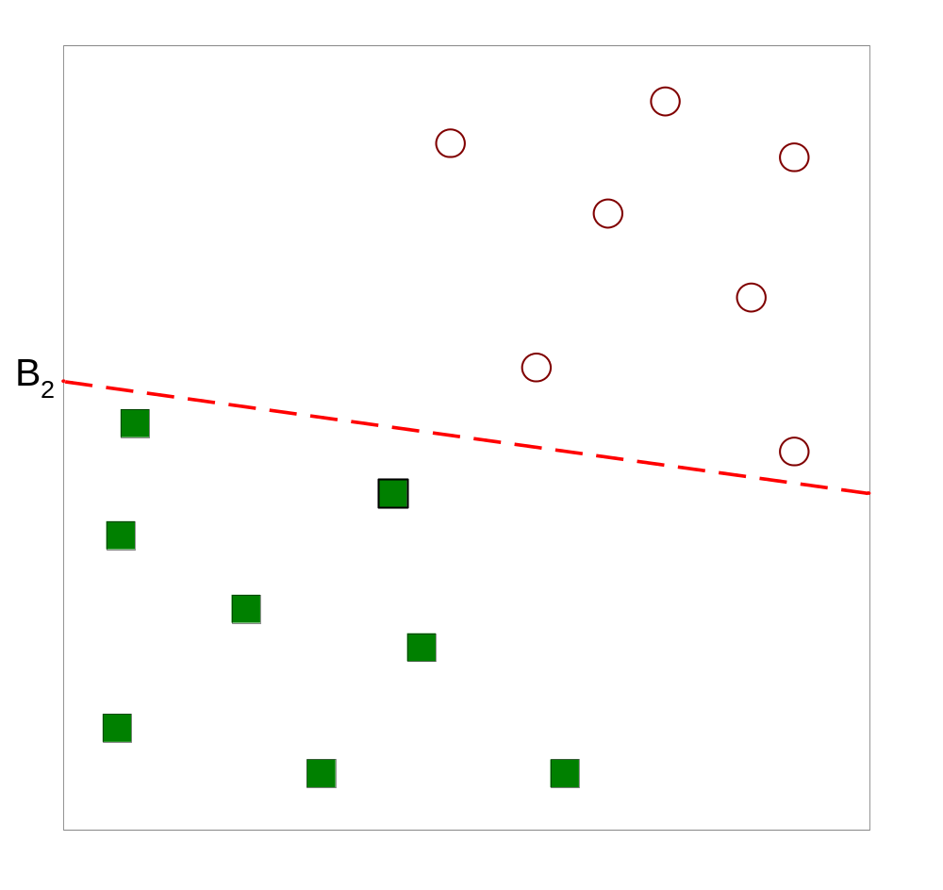
Support Vector Machines
Another possible solution

Slide 5
Support Vector Machines
Other possible solutions

Slide 6
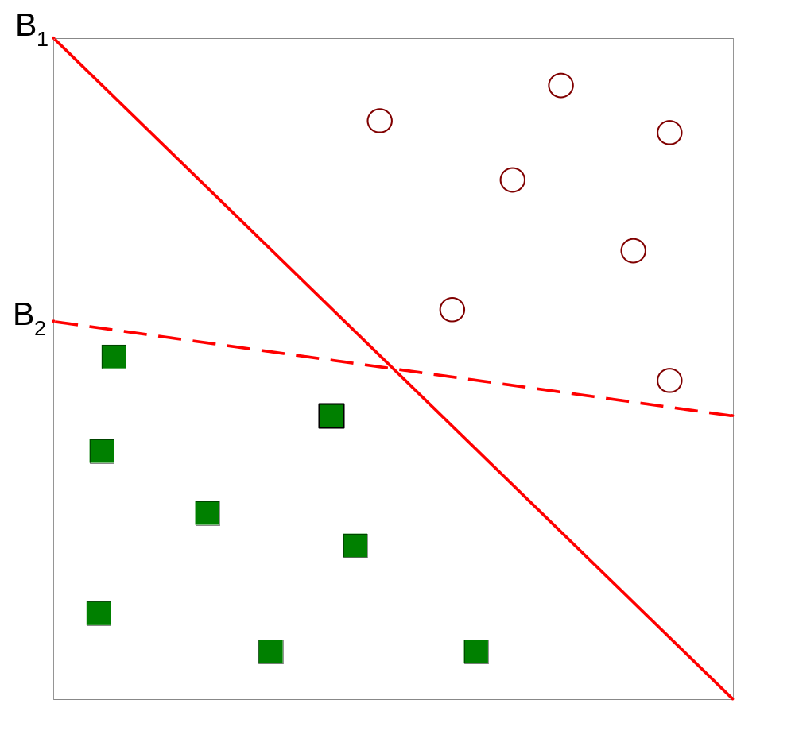
Support Vector Machines
Which one is better? B1 or B2?
How do you define better?

Slide 7
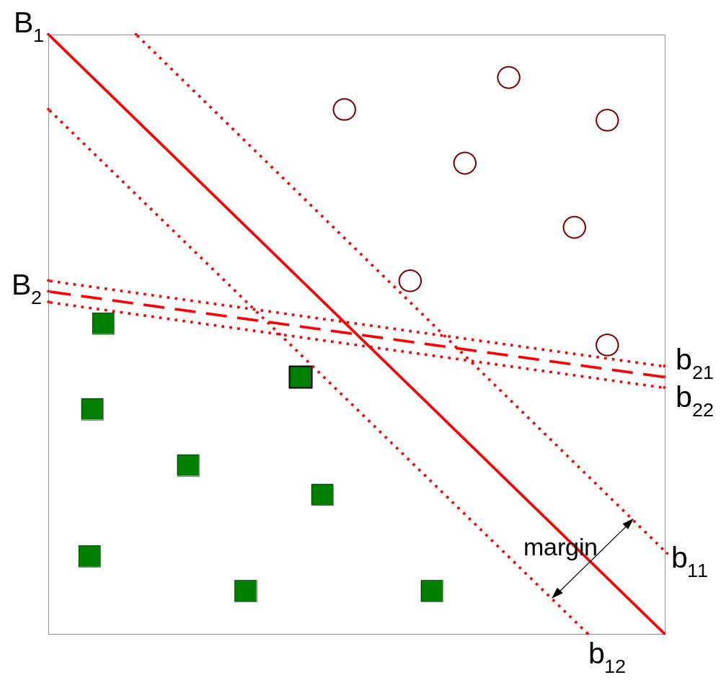
Support Vector Machines
Find hyperplane maximizes the margin => B1 is better than B2

Slide 8
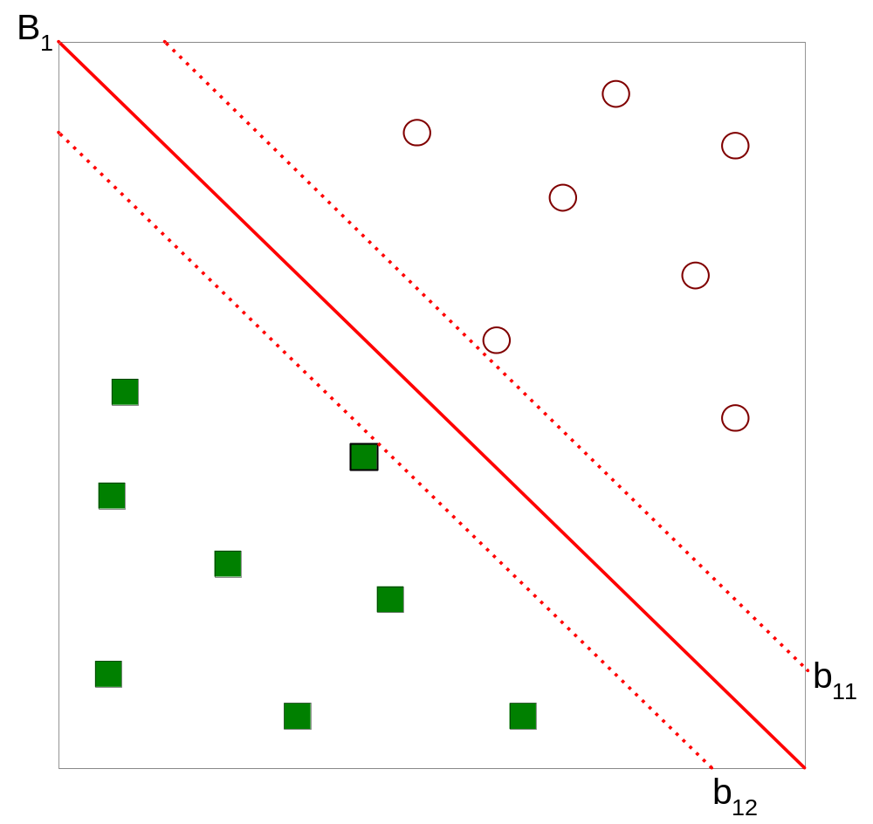



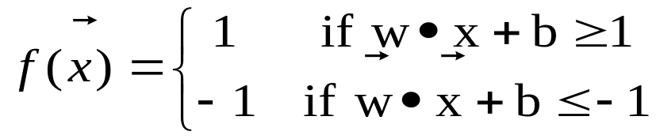
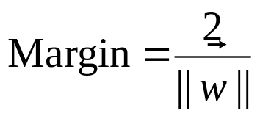
Support Vector Machines

Slide 9

Linear SVM
Linear model:
Learning the model is equivalent to determining the values of
  How to find from training data?

Slide 10

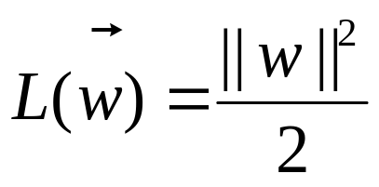
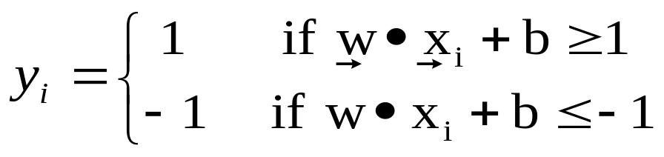
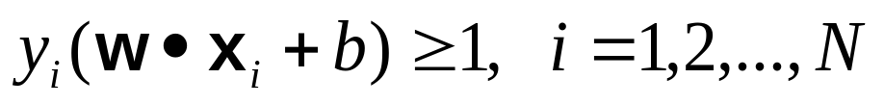
Learning Linear SVM
Objective is to maximize:
  Which is equivalent to minimizing:
  Subject to the following constraints:
  or
    This is a constrained optimization problem
      Solve it using Lagrange multiplier method

Slide 11

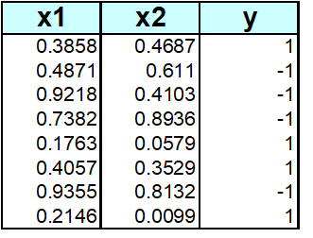
Example of Linear SVM

Slide 12
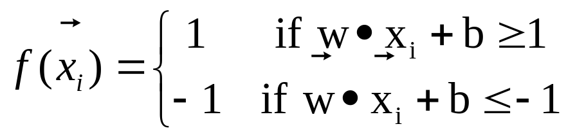
Learning Linear SVM
Decision boundary depends only on support vectors
  If you have data set with same support vectors, decision boundary will not change
  How to classify using SVM once w and b are found? Given a test record, x_{i}

Slide 13
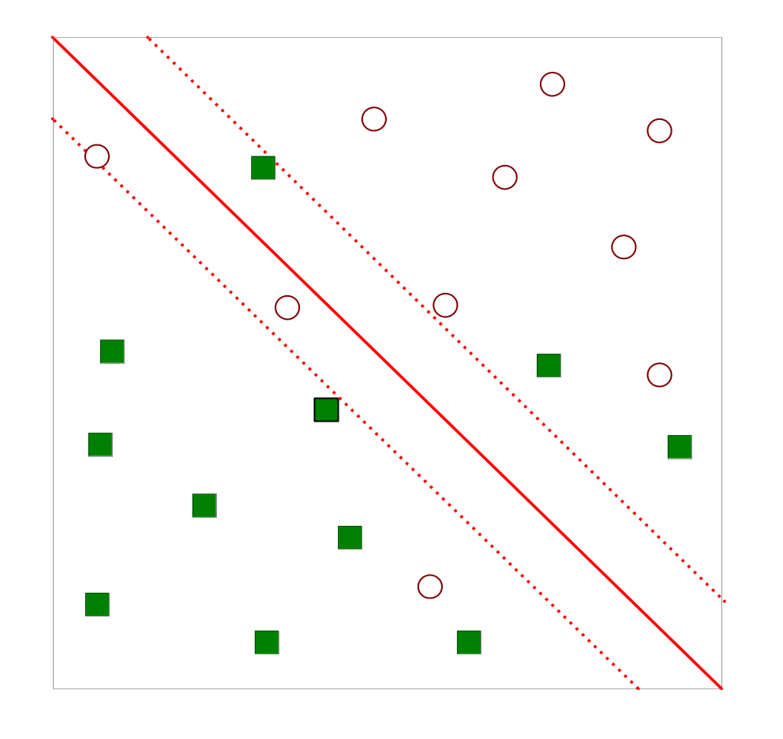
Support Vector Machines
What if the problem is not linearly separable?

Slide 14
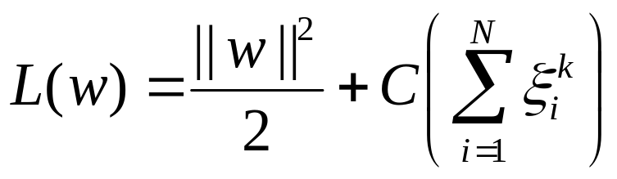
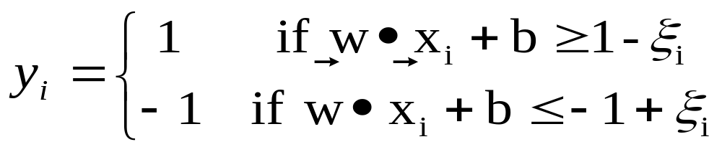
Support Vector Machines
What if the problem is not linearly separable?
  Introduce slack variables
    Need to minimize:
    Subject to:
    If k is 1 or 2, this leads to same objective function as linear SVM but with different constraints (see textbook)

Slide 15
Support Vector Machines
Find the hyperplane that optimizes both factors

Slide 16
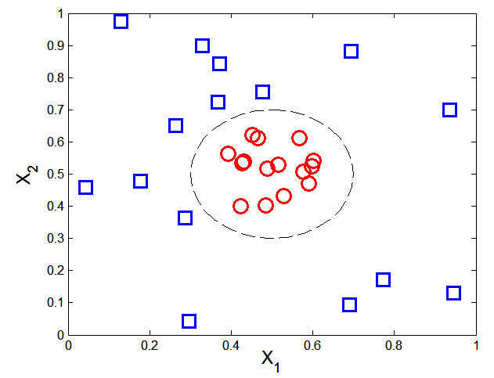

Nonlinear Support Vector Machines
What if decision boundary is not linear?

Slide 17
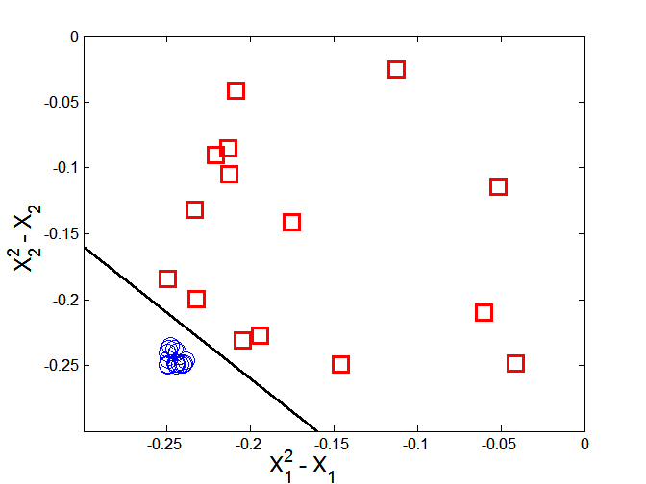



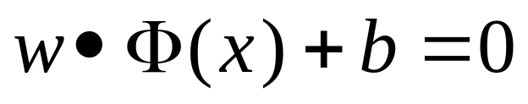
Nonlinear Support Vector Machines
Trick: Transform data into higher dimensional space
Decision boundary:

Slide 18
Learning NonLinear SVM
Issues:
  What type of mapping function Φ should be used?
  How to do the computation in high dimensional space?
    Most computations involve dot product Φ(x_{i})• Φ(x_{j})
    Curse of dimensionality?

Slide 19

Learning Nonlinear SVM
Kernel Trick:
  Φ(x_{i})• Φ(x_{j}) = K(x_{i}, x_{j})
  K(x_{i}, x_{j}) is a kernel function (expressed in terms of the coordinates in the original space)
    Examples:

Slide 20
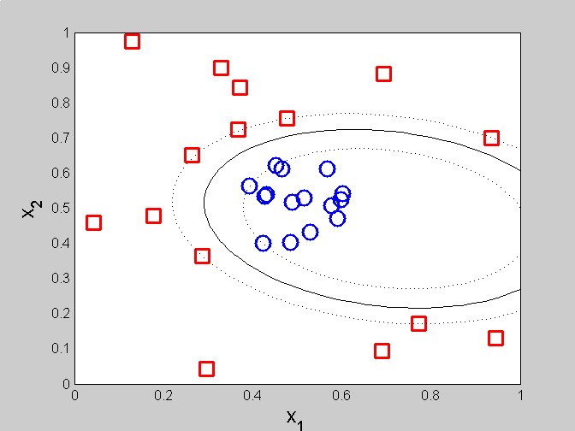
Example of Nonlinear SVM
SVM with polynomial degree 2 kernel

Slide 21
Learning Nonlinear SVM
Advantages of using kernel:
  Don’t have to know the mapping function Φ
  Computing dot product Φ(x_{i})• Φ(x_{j}) in the original space avoids curse of dimensionality
Not all functions can be kernels
  Must make sure there is a corresponding Φ in some high-dimensional space
  Mercer’s theorem (see textbook)

Slide 22
Characteristics of SVM
Since the learning problem is formulated as a convex optimization problem, efficient algorithms are available to find the global minima of the objective function (many of the other methods use greedy approaches and find locally optimal solutions)
Overfitting is addressed by maximizing the margin of the decision boundary, but the user still needs to provide the type of kernel function and cost function
Difficult to handle missing values
Robust to noise
High computational complexity for building the model

Slide 23
Regression
Typical Applications:
  Stock market: predict the share price for the future
  Energy demanding in a dam
  Wind speed: eolic energy
  Travel time prediction: for the planning of transport companies
  Level of water in a river: for safety & prevention
  Tax income: public budget
  …

Slide 24
Dataset subsets
Training set – used in model construction
Test set – used in model validation
Pruning set – used in model construction
(30% of training set)
Train/test (70% / 30%)

Slide 25
Regression
Regression analysis is used to:
  Predict the value of a dependent variable based on the value of at least one independent variable
  Explain the impact of changes in an independent variable on the dependent variable
Dependent variable:
  the variable we wish to predict or explain
Independent variable:
  the variable used to predict or explain the dependent variable

Slide 26
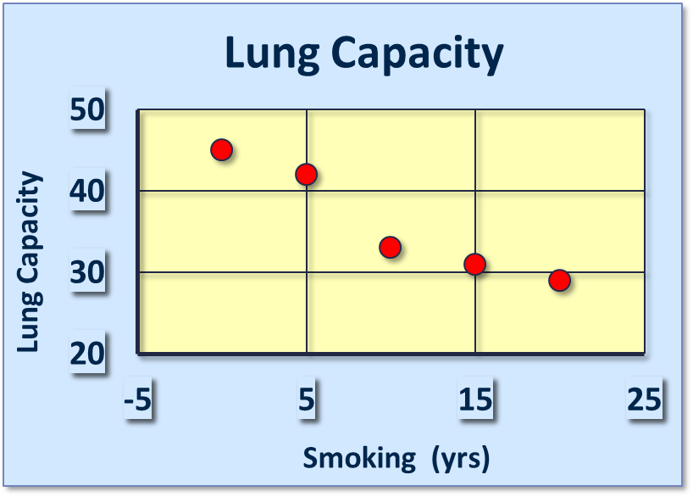
Simple Linear Regression Model
Only one independent variable, X
Relationship between X and Y is described by a linear function
Changes in Y
are assumed
to be related
to changes
in X

Slide 27
Types of Relationships
Strong relationships
Weak relationships
Y
Y
X
X
Y
Y
X
X

Slide 28
Types of Relationships
No relationship
Y
X
Y
X

Slide 29
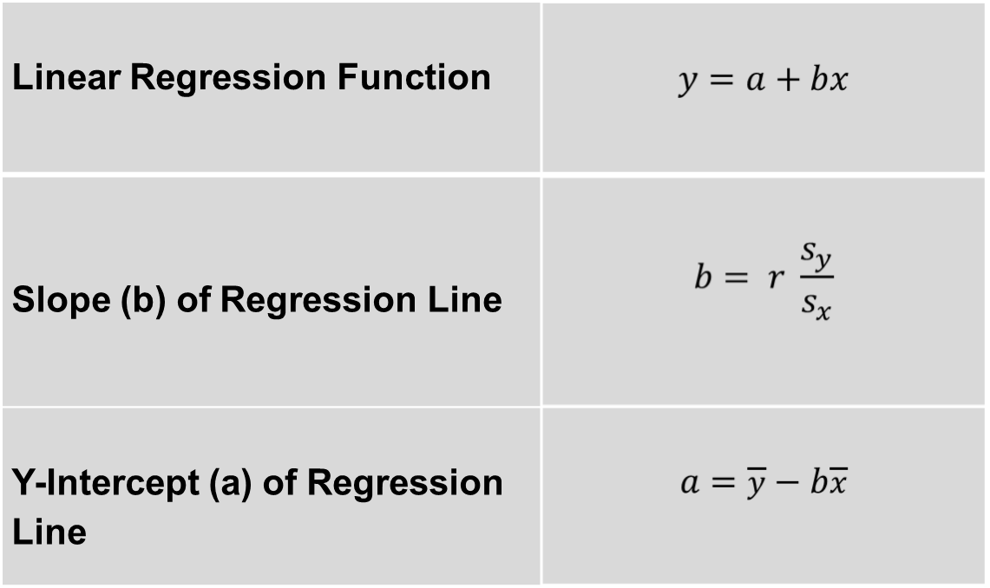
Simple Linear Regression Model

Slide 30
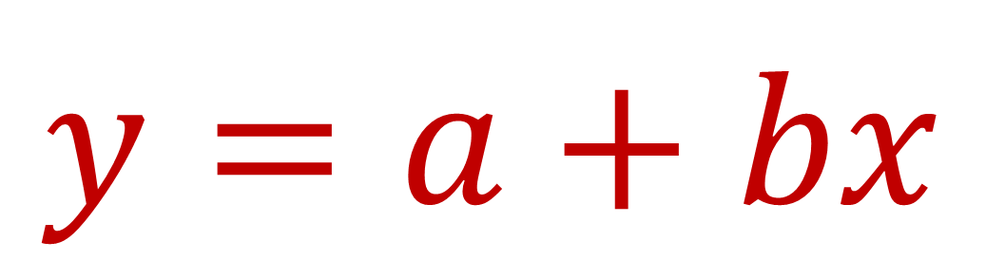
Linear Regression Function
Slope of Regression Line
Dependent Variable
Y intercept
Independent Variable
y = 0.79 + 0.43x
If x has a value of 2.5, what is the value of y?
y = 0.79 + 0.43x
= 0.79 + (0.43 * 2.5)
= 1.8475
Notes:
The simple linear regression equation provides an estimate of the population regression line

Slide 31
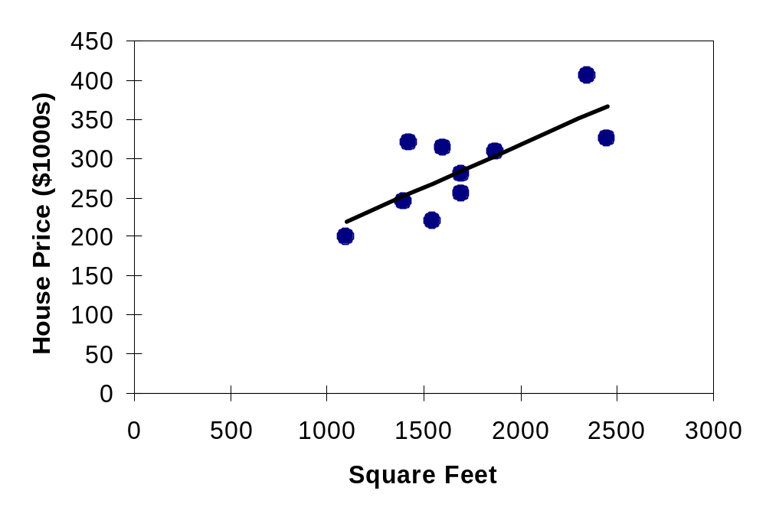
Making Predictions
When using a regression model for prediction, only predict within the relevant range of data
Relevant range
Do not try to extrapolate beyond the range of observed X’s
13-<number>

Slide 32
A two step process
2.Model usage
  For predicting future or unknown objects
  Estimate accuracy of the model
    The known target of test sample is compared with the classified result from the model
    For classification: accuracy rate is the percentage of test set samples that are correctly classified by the model
    For regression: mean squared error is the averaged squared error between each prediction and the corresponding target value
    Test set is independent of training set, otherwise over-fitting will occur

Slide 33


Model usage
Model
Unseen Data
Testing Data
(Jeff, Professor, 4)
NAME | RANK | YEARS | TENURED
Tom | Assistant Prof | 2 | no
Merlisa | Associate Prof | 7 | no
George | Professor | 5 | yes
Joseph | Assistant Prof | 7 | yes
Tenured?

Slide 34
Dataset subsets
Training set – used in model construction
Test set – used in model validation
Pruning set – used in model construction
(30% of training set)
Train/test (70% / 30%)

